Slide 1


R.M.K. COLLEGE OF ENGINEERING AND TECHNOLOGY RSM NAGAR, PUDUVOYAL - 601 206
DEPARTMENT OF ECE
PRODUCT DEVELOPMENT LAB I
II ECE C
.

Slide 2

LIGHT FidELITY-LIFI
Data transfer system
By
RESHMA.SK(111624104095)
HARINI.T(111624104106)

Slide 3
CONTENTS
1. INTRODUCTION
2. OBJECTIVES
3. LITERATURE REVIEW
4. EXISISTING SYSTEM
5. PROPOSED SYSTEM
6. METHODOLOGY
6. RESULTS & DISCUSSION
7. CONCLUSION
8. FUTURE SCOPE
9. REFERENCES
10.PUBLICATIONS

Slide 4
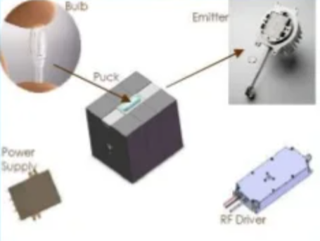
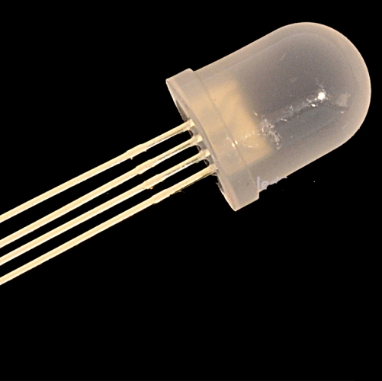
INTRODUCTION
Li-Fi (Light Fidelity) is a high-speed, bidirectional, and fully networked wireless communication technology that uses visible light instead of radio waves to transmit data. It operates by modulating the intensity of light emitted from an LED light source in such a way that it can be detected and decoded by a light-sensitive receiver, such as a photodiode or LDR.
In a Li-Fi data transfer system, an LED serves as the transmitter, converting digital data (0s and 1s) into rapid light pulses that are invisible to the human eye. The receiver, usually an LDR or photodiode, detects these changes in light intensity and converts them back into electrical signals, which are then processed by a microcontroller (such as an Arduino) to reconstruct the transmitted data

Slide 5

OBJECTIVES
Enhance Data Transmission Speed LiFi aims to deliver ultra-fast wireless communication, with speeds potentially exceeding 1 Gbps and even reaching up to 224 Gbps in lab conditions.
Reduce Network Congestion By shifting data transmission from radio frequencies to the visible light spectrum, LiFi helps offload traffic from overcrowded WiFi networks.
Enable Secure Communication Since light cannot penetrate walls, LiFi offers a more secure data transmission environment, reducing the risk of unauthorized access.

Slide 6
.
📚 LITERATURE REVIEW – LiFi Technology
Year | Authors | Method | Results/Parameters with Values | Features/Drawbacks
2013 | Haas et al. | VLC using LED modulation | Achieved data rates of 10 Mbps using off-the-shelf LEDs | Early prototype, limited range
2015 | Rajagopal et al. | IEEE 802.15.7 standard-based LiFi system | Bidirectional communication with 100 Mbps | Line-of-sight dependency
2017 | Ghassemlooy et al. | Hybrid LiFi/WiFi system | Improved coverage and reduced RF congestion | Complexity in handover management
2019 | Pathak et al. | LiFi for indoor positioning | Accuracy within 10 cm using LED grid | Requires dense LED deployment
2021 | Rozin et al. | Multi-user LiFi with OFDMA | Enhanced throughput and user fairness | High computational overhead
2023 | Ali, Khan, Hussain | Secure LiFi with encryption layer | Real-time encrypted data transfer at 1 Gbps | Increased system cost and power consumption

Slide 7
EXISISTING AND PROPOSED SYSTEMS
The "existing system theory" for Light Fidelity (Li-Fi) is fundamentally based on Visible Light Communication (VLC), where data is transmitted by modulating a light source, typically a Light-Emitting Diode (LED), at speeds imperceptible to the human eye. A Li-Fi system involves an LED transmitter in a Li-Fi access point encoding data into rapid on-off or intensity changes. A photodetector on a receiving device, such as a dongle or integrated chip, captures these light signals and converts them back into electrical signals and then into binary data. This system utilizes the optical spectrum, offering high speeds and enhanced security due to its confined nature, as signals cannot penetrate walls.

Slide 8
PRPOSED SYSTEM
A proposed system for Light Fidelity (Li-Fi) involves using light-emitting diodes (LEDs) to transmit data wirelessly by rapidly modulating their intensity, converting light energy into electrical signals with photodiodes at the receiver to achieve high-speed communication. The system leverages the large, unused visible light spectrum for data transfer, offering advantages over traditional radio-based Wi-Fi, such as higher speeds, greater security due to light's inability to pass through walls, and no need for a router.

Slide 9
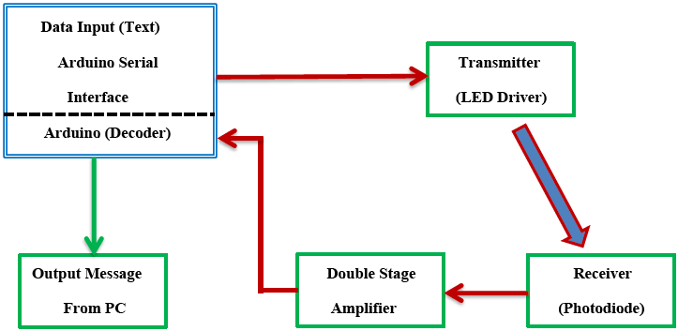
PROPOSED SYSTEM BLOCK DIAGRAM

Slide 10
IMPLEMENTATION & TESTING
implementing Li-Fi involves setting up a system with a modified LED light source (transmitter) to encode data into light, and a photo-detector (receiver) to decode the light fluctuations into digital data. Testing is done by evaluating data transfer rates, connection stability, range, and reliability by simulating real-world conditions, including the presence of obstacles and ambient light. Key test metrics include data throughput, latency, and signal integrity, often comparing Li-Fi's performance to established technologies like Wi-Fi and Bluetooth under varying conditions.

Slide 11
COMPONENTS
LED Transmitter: Emits modulated light signals to carry data.
Photodiode Receiver: Detects and converts light signals back into electrical data.
Modulation Circuit: Encodes digital data into light intensity variations.
Driver Circuit: Controls the LED’s brightness and switching speed.
Amplifier: Boosts the received signal for processing.
Signal Processing Unit: Decodes the received signal into usable data.
Power Supply: Powers the LED and electronic circuits.
Controller or Microprocessor: Manages data flow and system operations.

Slide 12
RESULTS
⚡ Performance Highlights
Speed: Li-Fi has achieved data transmission speeds of up to 1 Gbps in real-world scenarios, and even higher in lab conditions.
Latency: Extremely low latency makes it ideal for time-sensitive applications like industrial automation and real-time medical monitoring.
Security: Since light cannot penetrate walls, Li-Fi offers enhanced security compared to Wi-Fi, making it suitable for military and corporate environments.
Interference-Free: Operates in the visible light spectrum, which is 10,000 times broader than the radio frequency spectrum—resulting in reduced congestion and interference.
Energy Efficiency: Uses existing LED lighting infrastructure, minimizing additional power consumption.

Slide 13
CONCLUSION
Li-Fi is a new way to send data using light instead of radio waves. It works through LED bulbs and can give fast, secure internet. Since light can’t pass through walls, it’s safer and less likely to be hacked. Li-Fi is useful in places like hospitals, schools, and offices. As technology improves, Li-Fi could become a strong partner to Wi-Fi and help connect more devices in smarter ways.

Slide 14
FUTURE SCOPE
The futurescope for Light Fidelity (Li-Fi) involves widespread commercial deployment, integration with 5G networks, and the development of hybrid communication systems. Li-Fi's high-speed, secure data transfer is expected to serve the burgeoning Internet of Things (IoT) and smart cities, offering an alternative to congested radio-frequency spectrum. Key trends include advancements in Li-Fi hardware for increased accessibility and research into using the broader electromagnetic spectrum, beyond just visible light.

Slide 15
REFERENCES
original Concept:
Harald Haas’s 2011 TED Talk introducing Li-Fi as a wireless data communication technology using light.
Foundational Research:
Early academic papers by Haas and colleagues, laying the groundwork for visible light communication (VLC) and Li-Fi.
Survey & Review Articles:
Comprehensive surveys published by IEEE, ScienceDirect, and other publishers, summarizing the state of the art, challenges, and applications.
Academic Journals:
Research in the Journal of Lightwave Technology and similar journals, presenting experimental results, modulation techniques, and system designs.
Core Themes Covered:
Principles of Li-Fi technology.
Potential as a secure, high-speed alternative to Wi-Fi.
Use of the light spectrum (LEDs) for data transmission.

Slide 16
PUBLICATIONS
Publications for Light Fidelity (Li-Fi) include surveys by IEEE Xplore and ScienceDirect.com, conference papers such as "Light Fidelity: A future of wireless communication" on IEEE Xplore, and academic journals like the International Journal of Advanced Computer Science and Applications.
For comprehensive information, you can also find books by Harald Haas, the inventor of the term Li-Fi, and the Li-Fi Information website which also lists books and resources on the technology.

